Slide 1
Vibhaag Web App
A college analytics, session monitoring and
management tool
By,
Sudhanva N
PES1201702260
Karthik D
PES1201702449
Harsha K Y
PES1201801839
Guide:
Dr Veena S,
Chairperson,
Department of Computer
Applications

Slide 2
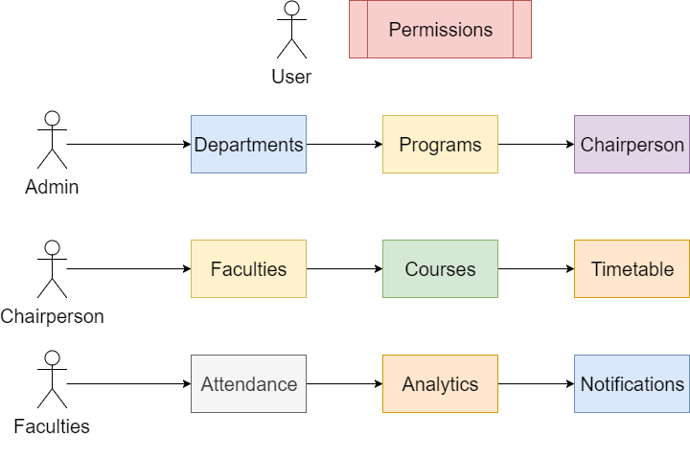
Features

Slide 3
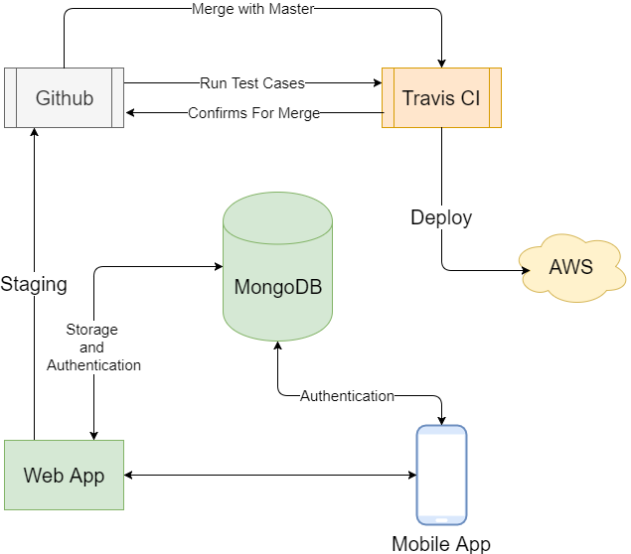
Technology

Slide 4
Key Features
Custom time table for every batch and for every session
Faculties can confirm the class conduction using mobile apps with timings
Meaningful insights such as daily and weekly abstracts can be generated
Admins have the ability to change the time table and re-allocate faculties as per requirement

Slide 5
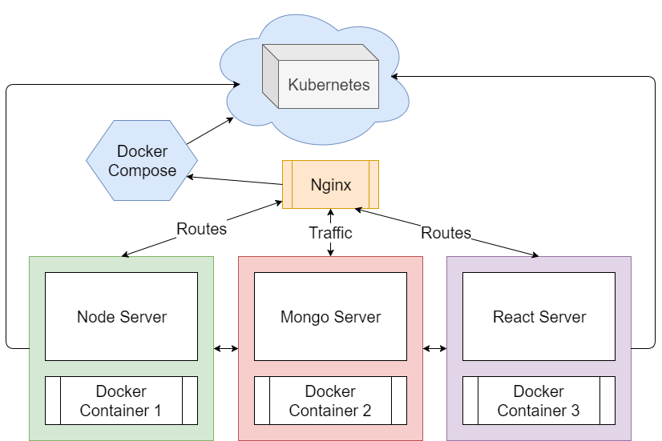
Architecture

